Slide 1


Build and optimize queries visually with Navicat
Navicat Certified Database Administrator - Associate

Slide 2

HKIIT - Navicat Certified Database Administrator - Associate
Lessons Intended Learning Outcome
On completion of this lesson(s), students are expected to be able to:
(#1) Use Navicat's Query Builder to create SELECT queries
(#2) Add WHERE condition to fetch specific data from a database
(#3) Apply aggregate functions and grouping records.
(#4) Retrieve data from two or more relational tables

Slide 3
HKIIT - Navicat Certified Database Administrator - Associate
Learning Outline
SELECT statement
WHERE clause with various comparison operators
Putting data in a specific order
Grouping rows of results into subsets based on the same value
Linking data between one (self-join) or more tables

Slide 4

HKIIT - Navicat Certified Database Administrator - Associate
COMMON TYPES
Database Objects
01
04
Tables
Functions
02
05
Triggers
Events
03
06
Views
Queries

Slide 5
HKIIT - Navicat Certified Database Administrator - Associate
DATABASE
Querying the Database - SELECT
The most common, important and complex task is to query a database for a subset of data that meets your needs - with the SELECT command.
The SELECT command has the following syntax:
SELECT field1, function_name(field2),... fieldN
FROM table_name1, table_name2...
[WHERE condition]
[GROUP BY field1, field2]
[HAVING condition]
[ORDER BY field1, field2]
[OFFSET M ][LIMIT N];

Slide 6

DATABASE
SELECT statement - Parameter Explanation
Parameter Name | Description
Field_name(s) | Specifies columns to return; Use * to returns all columns.
Table_name(s) | Names the tables to fetch data from.
WHERE | Optional; filters records based on conditions.
GROUP BY | Optional; groups records by specified columns.
HAVING | Optional; filters groups created by GROUP BY based on conditions.
ORDER BY | Optional; sorts records in the result set.
OFFSET | Optional; specifies the starting row (default is 0).
LIMIT | Optional; limits the number of records returned.
HKIIT - Navicat Certified Database Administrator - Associate

Slide 7
DATABASE
MySQL SELECT Statement Example
-- List all the rows of the specified columns
SELECT column1Name, column2Name, ... FROM tableName;
-- Alias a column in SELECT Statement
SELECT column_name AS alias_name FROM tableName;
-- List all the rows of ALL columns, * is a wildcard denoting all columns
SELECT * FROM tableName;
-- List rows that meet the specified criteria in WHERE clause
SELECT * FROM tableName WHERE criteria ;
HKIIT - Navicat Certified Database Administrator - Associate

Slide 8
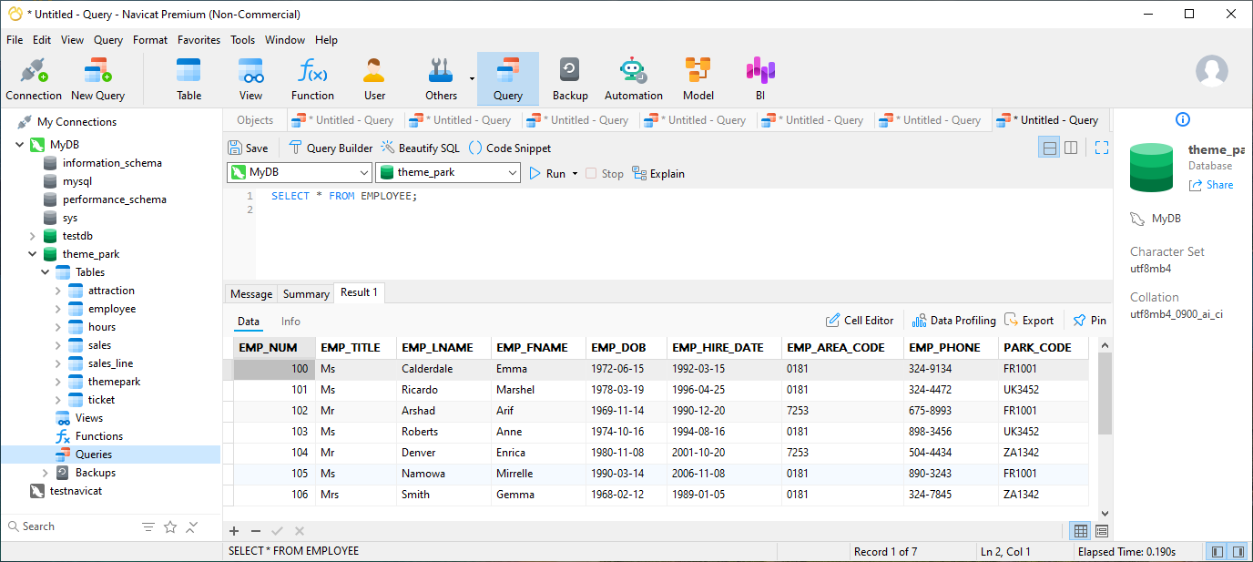
DATABASE
Querying the Database - SELECT
SELECT * FROM EMPLOYEE;
HKIIT - Navicat Certified Database Administrator - Associate

Slide 9
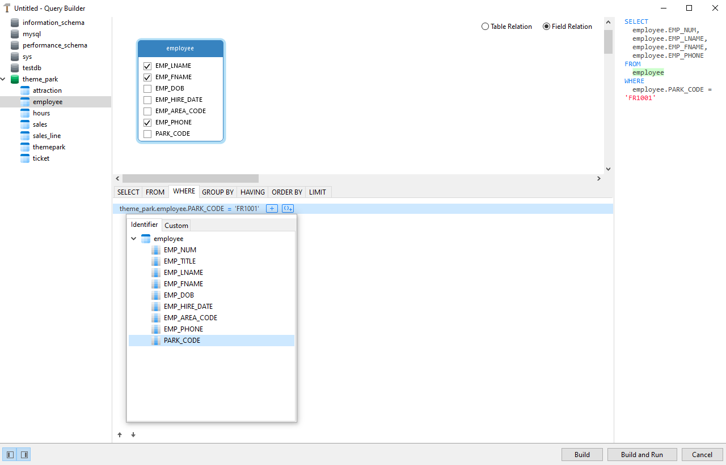
DATABASE
SQL - WHERE Clause
1. Specifies the columns to be displayed in the result.
2. Selects employees working at the theme park with the code 'FR1001'.
HKIIT - Navicat Certified Database Administrator - Associate

Slide 10
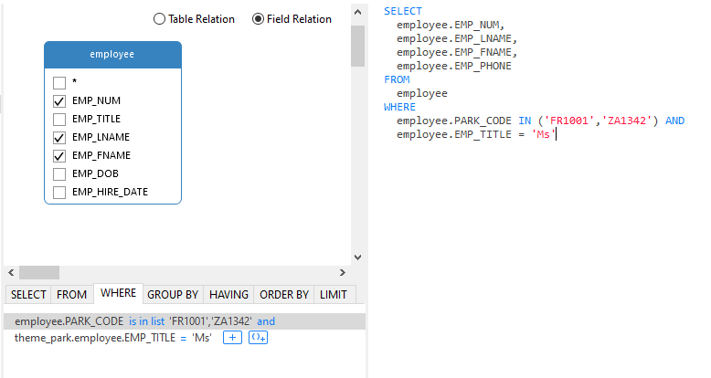
DATABASE
SQL - WHERE clause with 2 conditions
Utilise the AND or OR operators
The AND operator is used when both conditions must be true,
while the OR operator is used when either condition can be true.
HKIIT - Navicat Certified Database Administrator - Associate

Slide 11
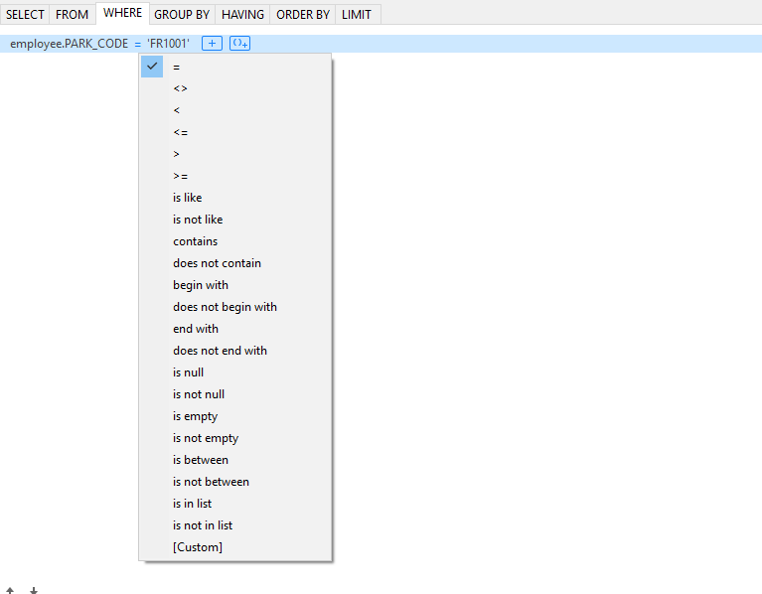
DATABASE
MySQL - Comparison Operators
Operator | Description
= | Equal to
> | Greater than
< | Less than
>= | Greater than or equal to
<= | Less than or equal to
<> | Not equal to
MySQL :: MySQL 8.4 Reference Manual :: 14.4.2 Comparison Functions and Operators
HKIIT - Navicat Certified Database Administrator - Associate

Slide 12
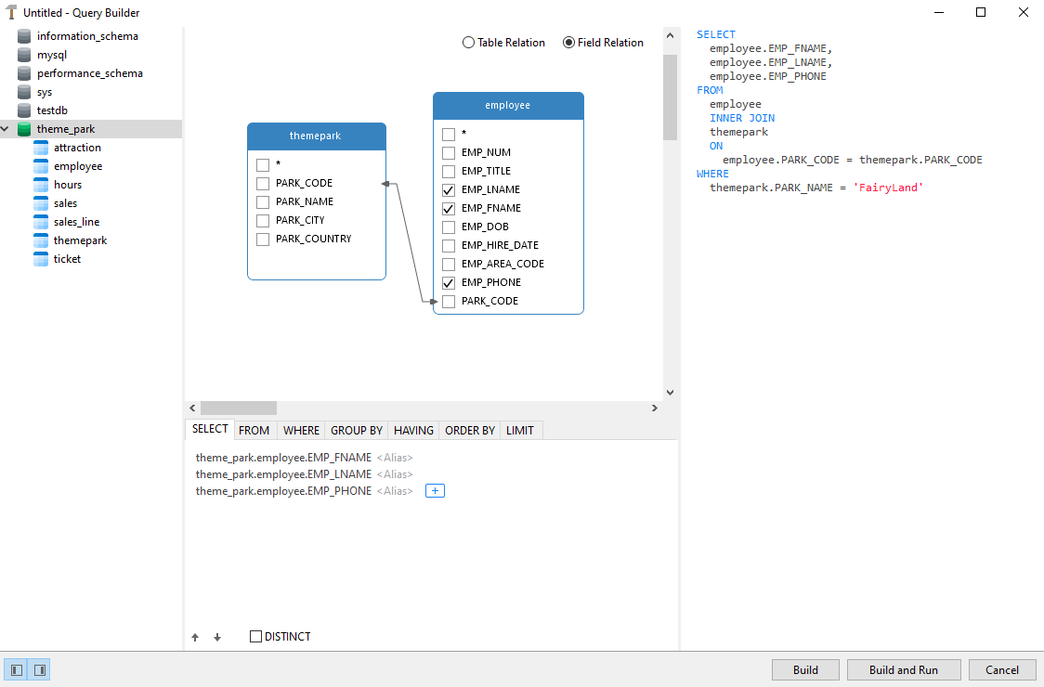
DATABASE
Query Builder in Navicat
Create graphical representations of tables
Simply by moving them to the empty area using drag-and-drop gestures.
The example query gets the
first name, last name, and phone number of employees
who work at "FairyLand."
HKIIT - Navicat Certified Database Administrator - Associate

Slide 13
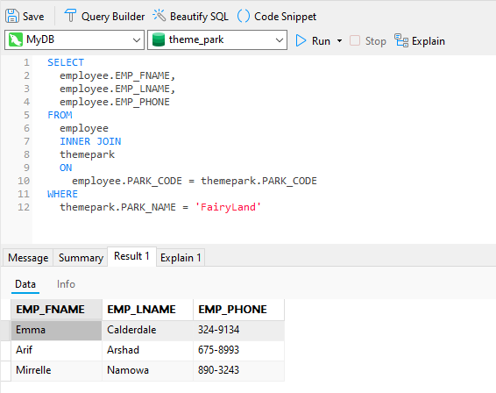
DATABASE
Query Builder in Navicat
1. Generate the SQL statement
2. Execute the statement
3. Return a set of results
HKIIT - Navicat Certified Database Administrator - Associate

Slide 14

Navicat
MySQL SELECT Statement
In this section, we covered the MySQL SELECT statement, including listing columns, aliasing, and using the WHERE clause with various comparison operators. We also discussed using Navicat for visual query design. This overview provides essential skills for data retrieval in MySQL.
HKIIT - Navicat Certified Database Administrator - Associate

Slide 15
SELECT QUERY
Column ordering
Show the employee ID, first and last names, and salary details in descending order of salary.
SELECT emp_id, firstname, lastname, salary
FROM employee
ORDER BY salary DESC;
Show the employee ID, first and last names, and salary details in order of title.
SELECT emp_id, firstname, lastname, title, salary
FROM employee
ORDER BY title ASC;
HKIIT - Navicat Certified Database Administrator - Associate

Slide 16
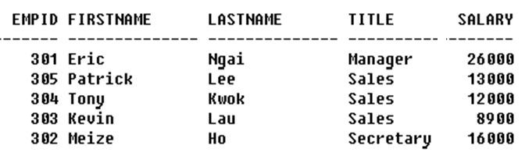
SELECT QUERY
Column ordering
Repeat the same query but arrange in order of title first; then in descending order of salary.
SELECT emp_id, firstname, lastname, title, salary
FROM employee
ORDER BY title ASC, salary DESC;
HKIIT - Navicat Certified Database Administrator - Associate

Slide 17
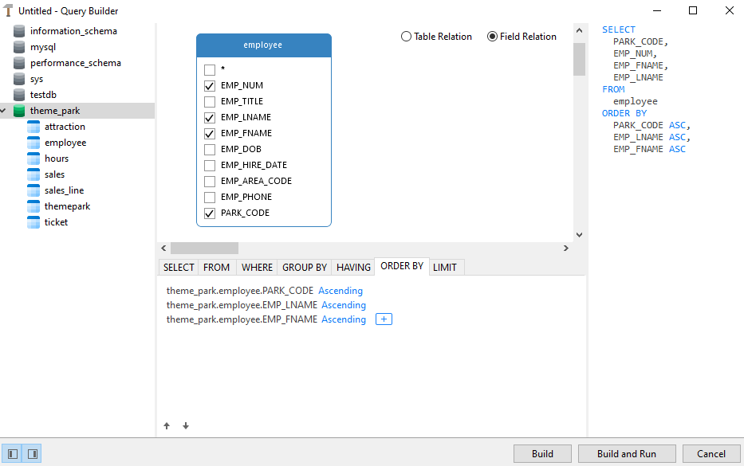
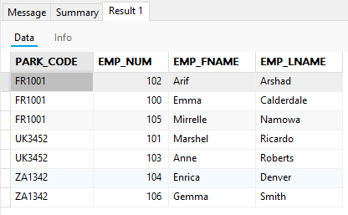
SELECT QUERY
Column ordering
Setting in Navicat
HKIIT - Navicat Certified Database Administrator - Associate

Slide 18
SELECT QUERY
Aggregate Functions
Perform calculations on multiple values and return a single value.
Functions | Descriptions
SUM() | Adds up all the values in a column
AVG() | Calculates the average of the values in a column.
COUNT() | Counts the number of rows.
MIN() | Finds the smallest value.
MAX() | Finds the largest value.
Syntax: SELECT SUM(column_name) FROM table_name;
Example: SELECT SUM(Salary) FROM Employee;
MySQL :: MySQL 8.4 Reference Manual :: 14.19.1 Aggregate Function Descriptions
HKIIT - Navicat Certified Database Administrator - Associate

Slide 19
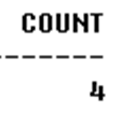
SELECT QUERY
Select: count( )
How many products its unit price are more than 500?
SELECT COUNT(*) AS count
FROM product
WHERE unit_price > 500;
How many different employees have made orders in Oct 12?
SELECT COUNT(DISTINCT emp_id) AS count
FROM orders
WHERE order_date BETWEEN ‘01-OCT-12' AND '31-OCT-12';
MySQL :: MySQL 8.4 Reference Manual :: 14.19.1 Aggregate Function Descriptions
HKIIT - Navicat Certified Database Administrator - Associate

Slide 20
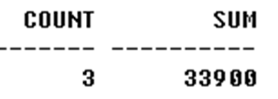
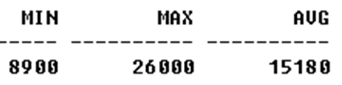
SELECT QUERY
Select: sum, min, max, avg
Find number of sales and sum of their salaries.
SELECT COUNT(emp_id) AS count, SUM(salary) AS sum
FROM employee
WHERE title = 'Sales';
Find minimum, maximum, and average employee salary.
SELECT MIN(salary) AS min,
MAX(salary) AS max,
AVG(salary) AS avg
FROM employee;
MySQL :: MySQL 8.4 Reference Manual :: 14.19.1 Aggregate Function Descriptions
HKIIT - Navicat Certified Database Administrator - Associate

Slide 21
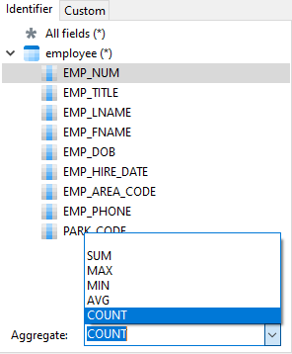
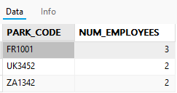
SELECT QUERY
Grouping Data
- Used to group rows that have the same values.
Combining Aggregate Functions with GROUP BY
Setting in Navicat
Example: To count the number of employees per theme park.
SELECT PARK_CODE, COUNT(EMP_NUM) AS NUM_EMPLOYEES
FROM EMPLOYEE
GROUP BY PARK_CODE;
Return Data:
HKIIT - Navicat Certified Database Administrator - Associate

Slide 22
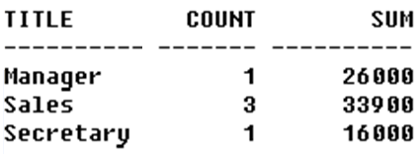
SELECT QUERY
Grouping Data
- Used to group rows that have the same values.
Use GROUP BY clause to get sub-totals.
Example: Find number of employees in each job title and their total salaries.
Sort the result in alphabetical order of job title.
SELECT title, COUNT(emp_id) AS count, SUM(salary) AS sum
FROM employee
GROUP BY title
ORDER BY title ASC;
HKIIT - Navicat Certified Database Administrator - Associate

Slide 23
SELECT QUERY
Restricted grouping
Use HAVING clause with GROUP BY to restrict groups that appear in final result table
Similar to WHERE, but WHERE filters individual rows whereas HAVING filters groups
Column names in HAVING clause must also appear in the GROUP BY list or be contained within an aggregate function
HKIIT - Navicat Certified Database Administrator - Associate

Slide 24
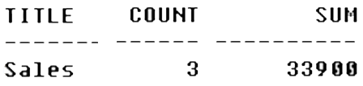
SELECT QUERY
Select: group by … having
For each job title with more than 1 employee, find the number of employees in each job title and the sum of their salaries. Sort the result in alphabetical order of job title.
SELECT title, COUNT(emp_id) AS count, SUM(salary) AS sum
FROM employee
GROUP BY title
HAVING COUNT(emp_id) > 1
ORDER BY title ASC;
HKIIT - Navicat Certified Database Administrator - Associate

Slide 25
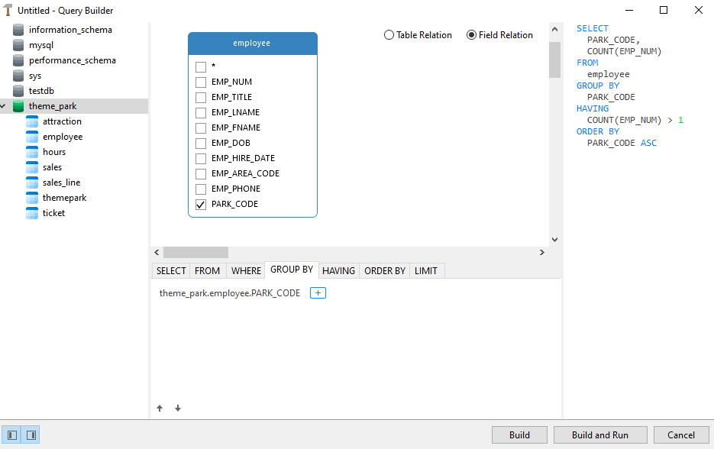
SELECT QUERY
Navicat Query Builder: group by
HKIIT - Navicat Certified Database Administrator - Associate

Slide 26
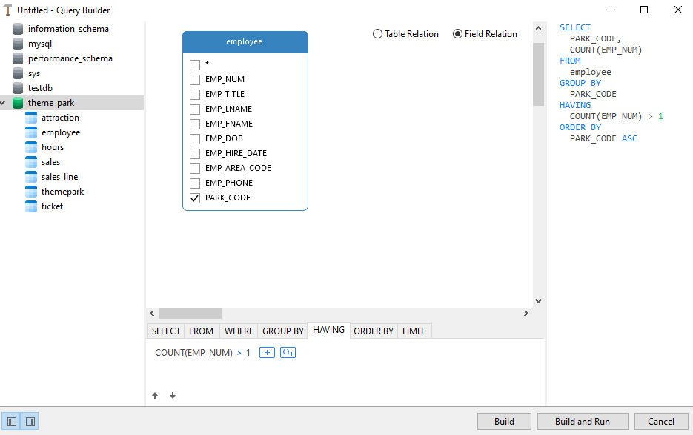
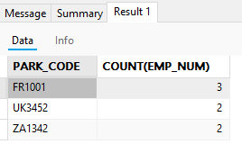
SELECT QUERY
Navicat Query Builder: group by … having
HKIIT - Navicat Certified Database Administrator - Associate

Slide 27
Navicat
MySQL SELECT Statement
In this section, we covered the MySQL GROUP BY, HAVING, ORDER BY clauses and aggregate functions. These clauses and functions help organize and analyze data effectively in MySQL.
HKIIT - Navicat Certified Database Administrator - Associate

Slide 28
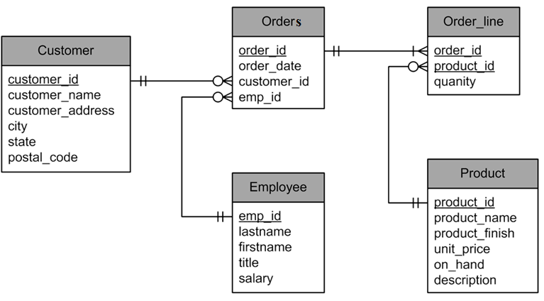
SELECT QUERY
Case study: Multi-tables query
HKIIT - Navicat Certified Database Administrator - Associate

Slide 29
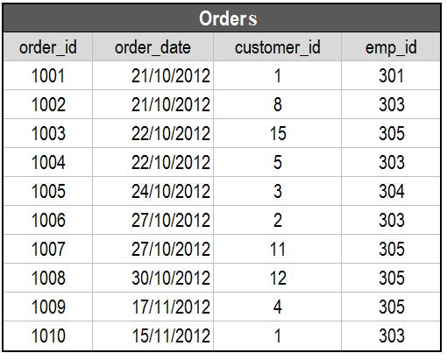
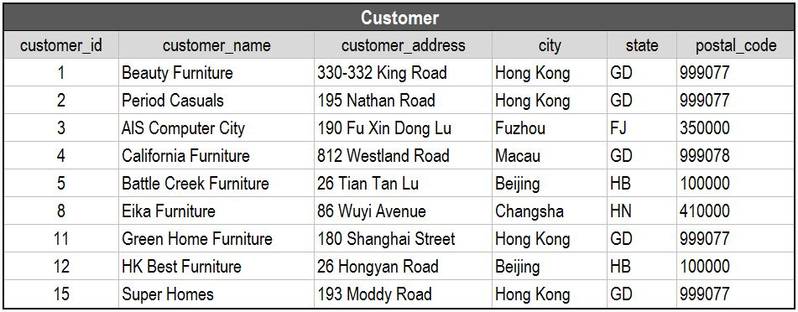
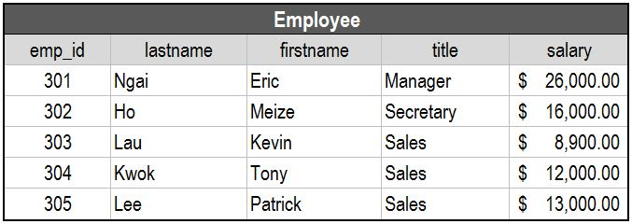
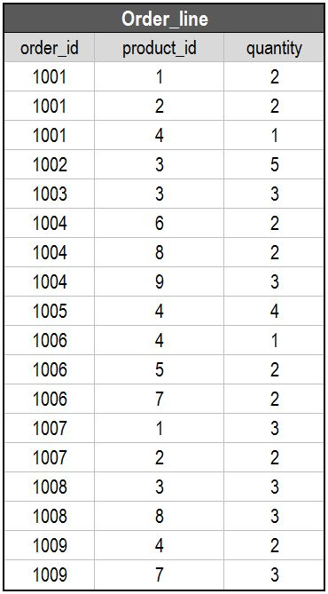
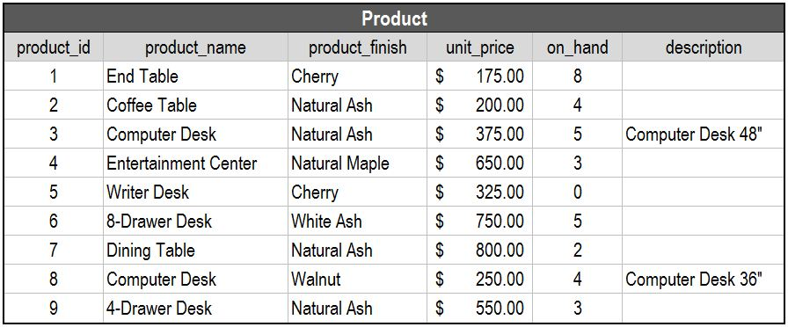
Sample
Data
HKIIT - Navicat Certified Database Administrator - Associate

Slide 30

SELECT QUERY
Select: Multi-tables query
Result columns come from more than one table must use a JOIN and the query is a multi-tables query. Combining two or more tables based on a common field between them
SELECT tablename1.colunmnname, tablename2.columnname FROM tablename1
JOIN tablename2
ON tablename1.colunmnname = tablename2.columnname
ORDER BY columnname;
HKIIT - Navicat Certified Database Administrator - Associate

Slide 31
SELECT QUERY
Cartesian Product
Combine two tables, no matter they are “related” or not.
Cartesian Product of two tables contains all columns from both tables, and all possible combinations of the rows from both tables.
Example:
A table of m rows, p columns and a table of n rows, q columns will produce a table of (m × n) rows, (p + q) columns
HKIIT - Navicat Certified Database Administrator - Associate

Slide 32
SELECT QUERY
Cartesian Product
Cartesian product gives all possible combinations.
The result is not meaningful in most cases.
HKIIT - Navicat Certified Database Administrator - Associate

Slide 33
SELECT QUERY
Inner Join
An inner join is a Cartesian Product operation followed by a selection with criteria.
It removes those “meaningless” cartesian product results
Specify the column as join condition
SELECT *
FROM orders, order_line
WHERE orders.order_id = order_line.order_id;
ANSI provides a special format for this
SELECT *
FROM orders INNER JOIN order_line
ON orders.order_id = order_line.order_id;
HKIIT - Navicat Certified Database Administrator - Associate

Slide 34
SELECT QUERY
Multi-tables query
Show the order id, the order date, the customer name and the name of employee who handles the order
SELECT order_id, order_date, customer_name, firstname
FROM orders, customer, employee
WHERE orders.customer_id = customer.customer_id AND
orders.emp_id = employee.emp_id ;
HKIIT - Navicat Certified Database Administrator - Associate

Slide 35
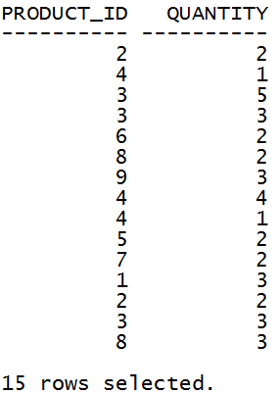
SELECT QUERY
More join example
Show the product ID, quantity of those products that are ordered by customer in October of 2012.
SELECT product_id, quantity
FROM orders AS O, order_line AS OL
WHERE O.order_id = OL.order_id
AND order_date LIKE '%-OCT-12' ;
HKIIT - Navicat Certified Database Administrator - Associate

Slide 36
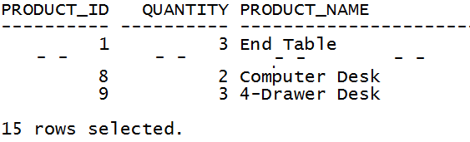
SELECT QUERY
More join example
Show the product ID, product name, quantity of those products that are ordered by customer in October of 2012.
SELECT OL.product_id, quantity, product_name
FROM orders AS O, order_line AS OL, AS product P
WHERE O.order_id = OL.order_id AND
OL.product_id = P.product_id AND
order_date LIKE '%-OCT-12' ;
HKIIT - Navicat Certified Database Administrator - Associate

Slide 37
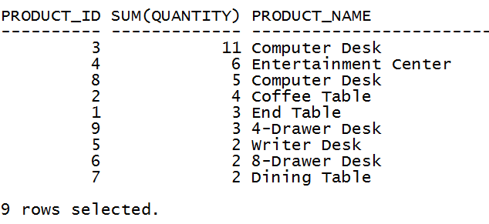
SELECT QUERY
More join example
Show the product ID, name, total quantity of products that are ordered by customer in October 2012. Display those products which have total quantity more than 1. Sort the result in descending order of total quantity, then in ascending order of product ID.
SELECT P.product_id, SUM(quantity), product_name
FROM orders O, order_line OL, product P
WHERE O.order_id = OL.order_id AND
OL.product_id = P.product_id AND
order_date LIKE '%-OCT-12'
GROUP BY P.product_id, product_name
HAVING SUM(quantity) > 1
ORDER BY SUM(quantity) DESC, P.product_id ASC;
Example – query result
HKIIT - Navicat Certified Database Administrator - Associate

Slide 38
SELECT QUERY
More join example
Show the product ID, name, total quantity of products that are ordered by customer in October 2012. Display those products which have total quantity more than 1. Sort the result in descending order of total quantity, then in ascending order of product ID.
SELECT P.product_id, SUM(quantity), product_name
FROM orders O, order_line OL, product P
WHERE O.order_id = OL.order_id AND
OL.product_id = P.product_id AND
order_date LIKE '%-OCT-12'
GROUP BY P.product_id, product_name
HAVING SUM(quantity) > 1
ORDER BY SUM(quantity) DESC, P.product_id ASC;
Example – query result
HKIIT - Navicat Certified Database Administrator - Associate

